Slide 1
REPORT ON COVID19 CASES BY DAN-IMAM ABIOLA SAMIAT 3MTT FELLOW ON DATA ANALYSIS AND VISUALISATION

Slide 2
LIST OF CONTENT
Introduction
Statement of the problem
Aims and Objectives
Results
Recommendation
Conclusion

Slide 3
Introduction
What this report contain is data on the new pandemic disease of Covid19 also known as Corona Virus from various states across the nation, the number of cases and how to tackle it.

Slide 4
Statement of the problem
To know the number of people affected or infected with the virus(disease).
To find ways on how to reduce and prevent the spread of the virus.

Slide 5
Aims and Objectives
To know the exact number of victims
To know the rate of death of infected victims
To find out ways to reduce the spread of the disease
To find out ways to prevent and protect oneself from getting infected

Slide 6
About the dataset
The dataset used in this report contains record on covid19 cases from different states, the number of recovered victims and dead victims.

Slide 7
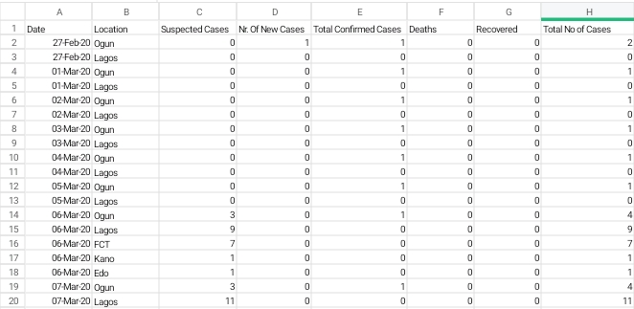
Below is how the dataset looks like,

Slide 8
Analysis of the data
The table below shows the summation of cases gotten from the 7 states chosen for this analysis, dated from 27th Feb 2020 to 13th Mar 2020.
Cases | Sum
Sum of suspected cases | 213
Sum of new cases | 2
Sum of confirmed cases | 16
Sum of recovered | 1
Sum of death | 0

Slide 10
Results and insight
Suspected Cases; from the dataset and analysis above, you can see that the number of suspected cases keeps fluctuating between the dates.
New cases; the number of new cases is very few.
Confirmed cases; the cases that are confirmed as covid19 victims is also low, that means not all the suspected cases are proven to be infected with the virus.
Death; non of the victims i.e. both suspected and confirmed is dead as a result of the disease.
Recovered: only one% of the victims get to recover from the disease of covid19.

Slide 11
Recommendation
The government should provide healthcare workers with personal Protective Equipment(PPE) as it helps in reducing and preventing the spread of the virus from one patient to another.
The community should be educated on social distancing as the virus is spread through the air, when the infected person talks or cough.
Hand washing should be made a compulsory protocol before entering any facility or place with lots of people.
The wearing of facemask should be mandated on everyone both infected and non infected, to prevent the infected person from spreading the disease and to protect the non infected from getting infected.
Isolating centers should be made available in all hospitals to separate infected people from non infected people.

Slide 12
Conclusion
We understand from the analysis that the spread of the disease is usually from the lack of knowledge on the new disease and ways to prevent its spread.
There is need for the government to enact law enforcement that will prevent the spread of this new disease like wearing of facemasks when going anywhere, ensuring social distancing in every crowded place and washing of hands before entering all buildings.

Slide 13
THANK YOU
FOR LISTENING!!!

